Slide 1

Ph.D. Mirek Sienkiewicz
Vice-president of FACEnetwork
Small Scale Farm Dairies Conference 2019
Rakvere, 4 October

Slide 2
What is FACEnetwork?
Who are we representing?
Small Scale Farm Dairies Conference, Rakvere 4 October 2019

Slide 3
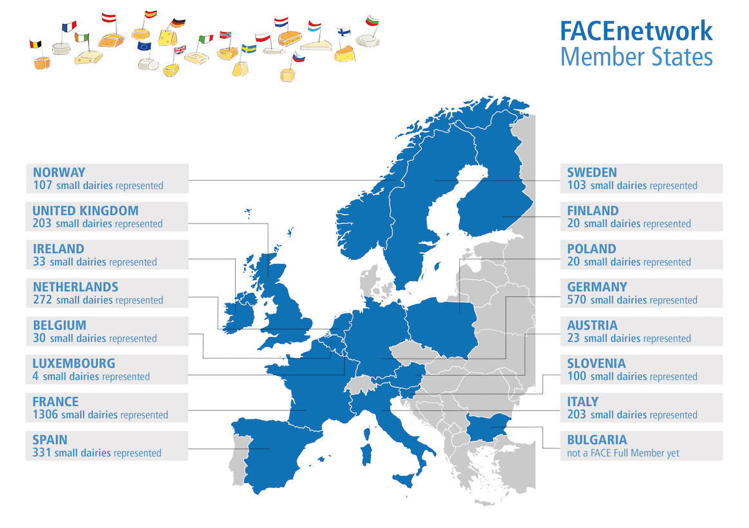
18 associations of producers (3 172 cheesemakers members) in 16 countries
Small Scale Farm Dairies Conference, Rakvere 4 October 2019

Slide 4

What is FACEnetwork?
We represent 2 types of microenterprises:
"Farmhouse" cheese and dairy producers: process milk from at least the majority of their own livestock
"Artisan“ cheese and dairy producers: collect milk from local farmers and process it in small structures
The milk can come from cows, sheep and goats...
In all cases, these are generally family businesses, which make locally recognized products based on traditional methods and specific know-how.

Slide 5
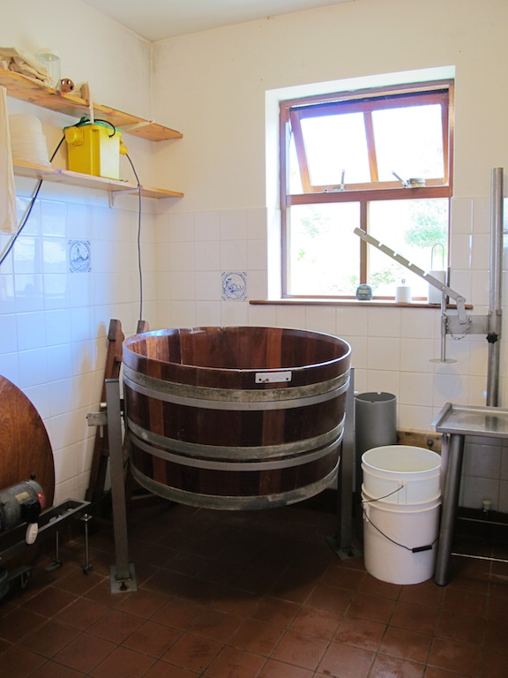
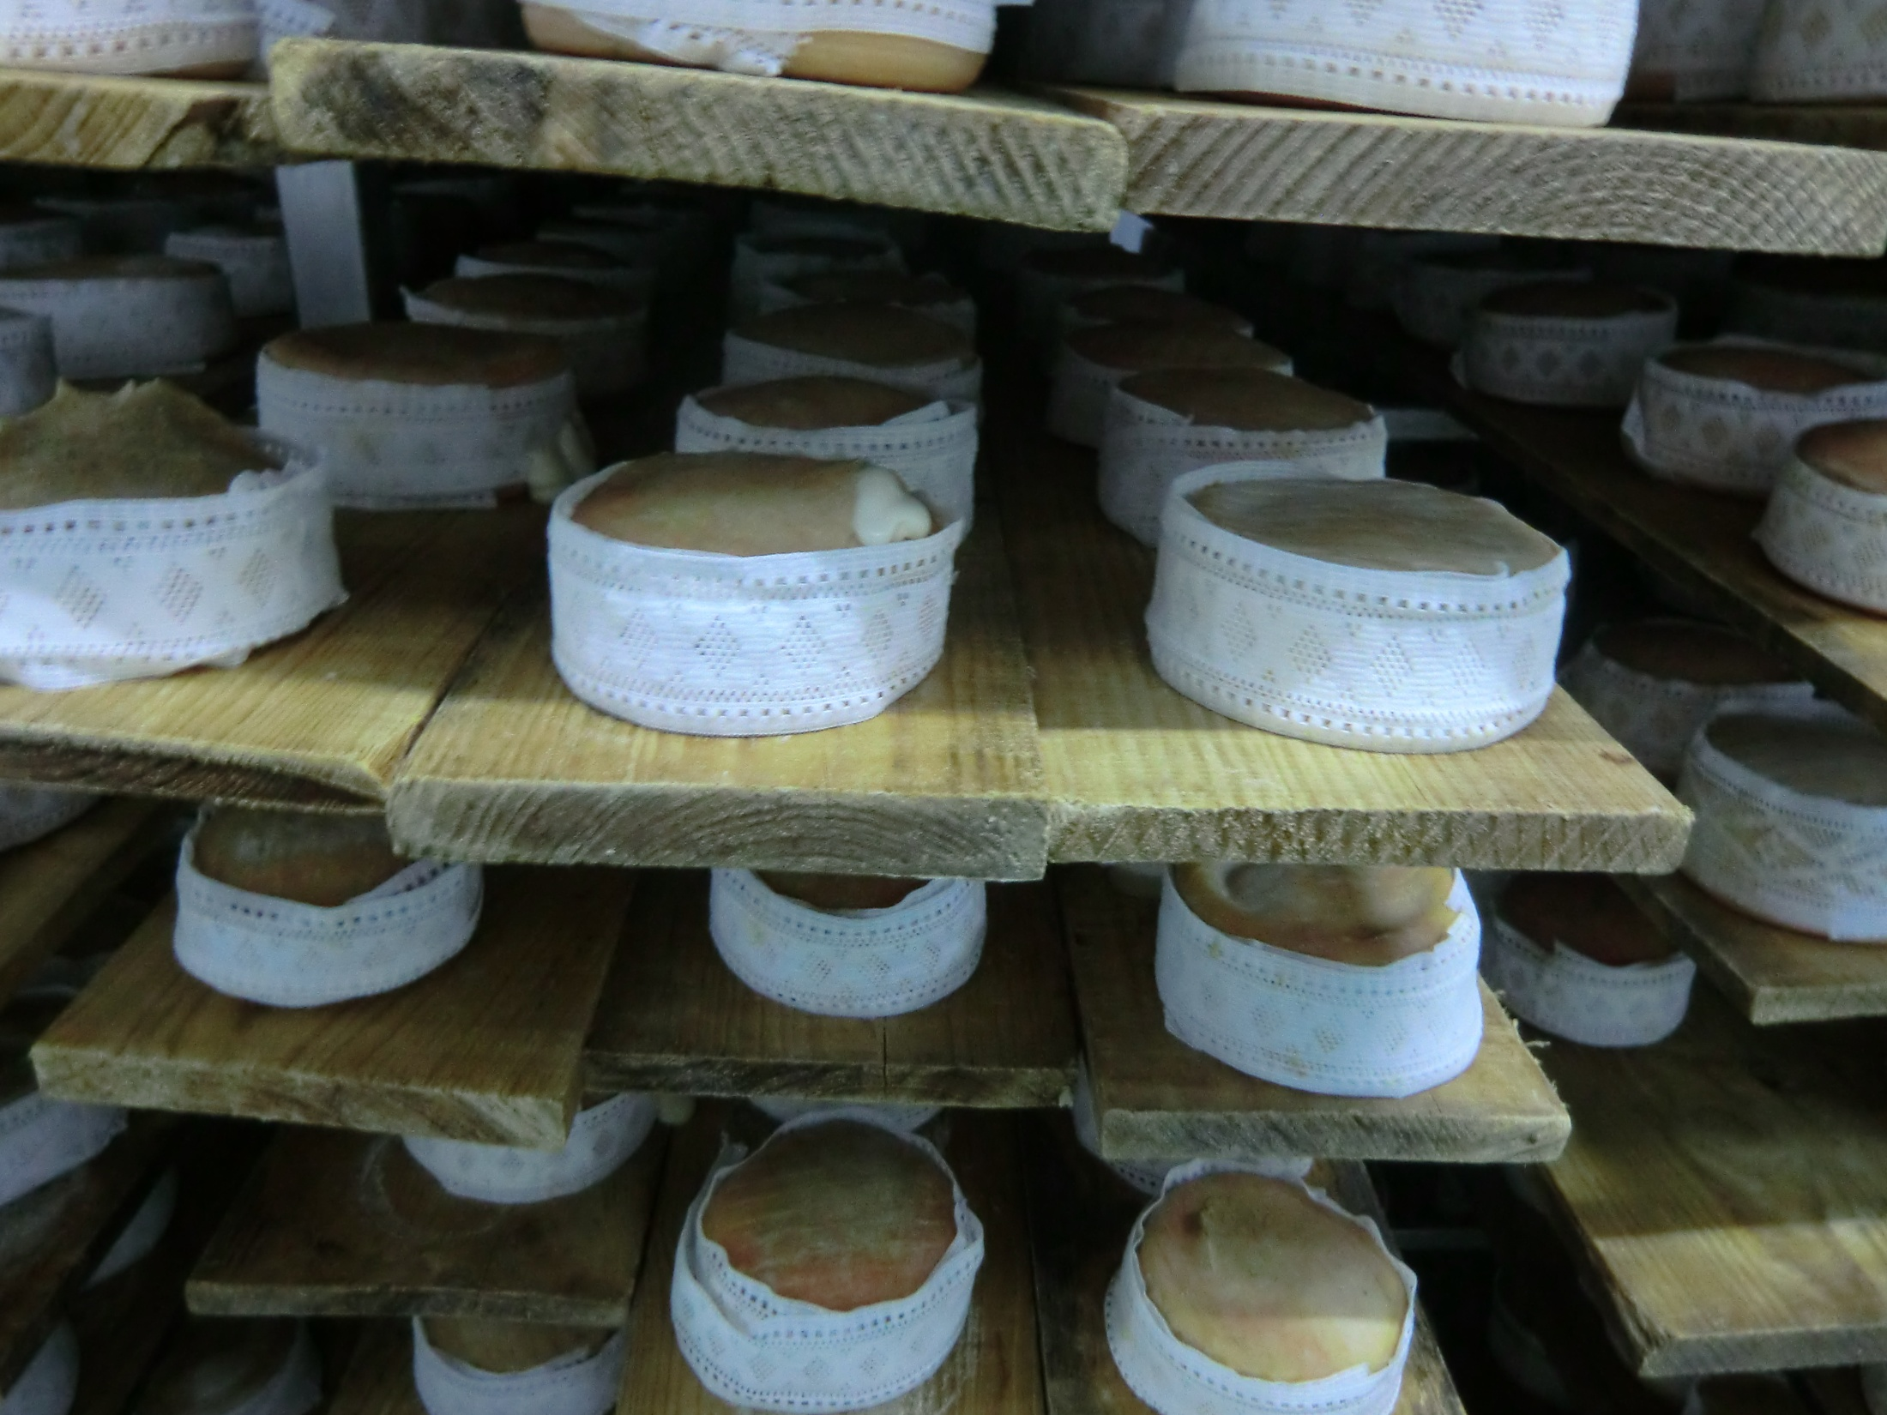
Who are the farmhouse and artisan
cheese and dairy producers?
We keep on using traditional process, equipment, premises and raw milk
And we can comply perfectly with regulations
Notes:
PREMISES TOOLS AND EQUIPMENT

Slide 6
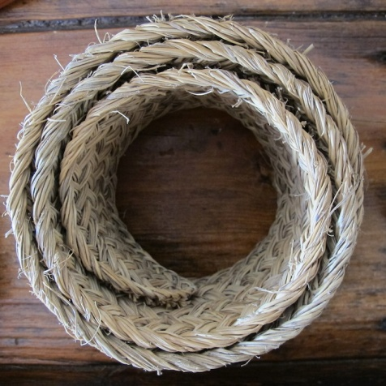
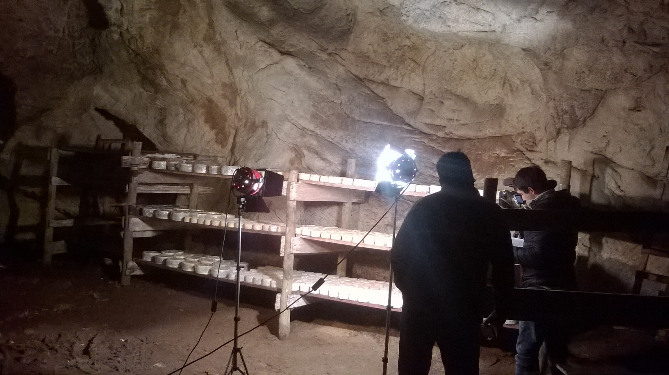
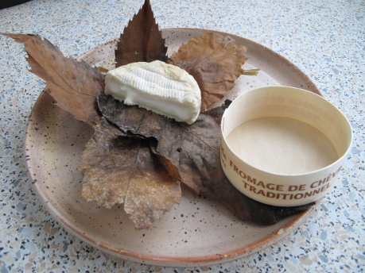
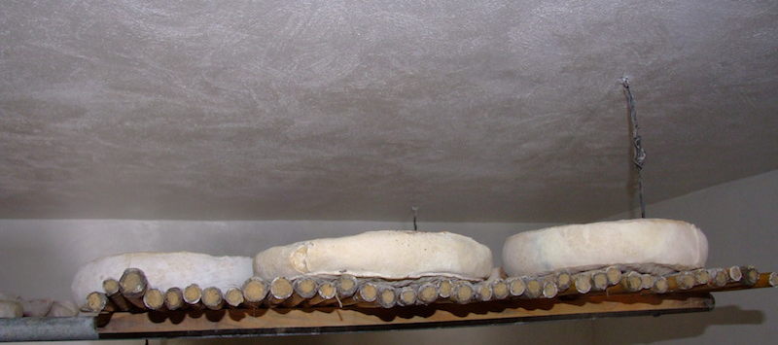
Who are the farmhouse and artisan
cheese and dairy producers?
We keep on using traditional process, equipment, premises and raw milk
And we can comply perfectly with regulations

Slide 7
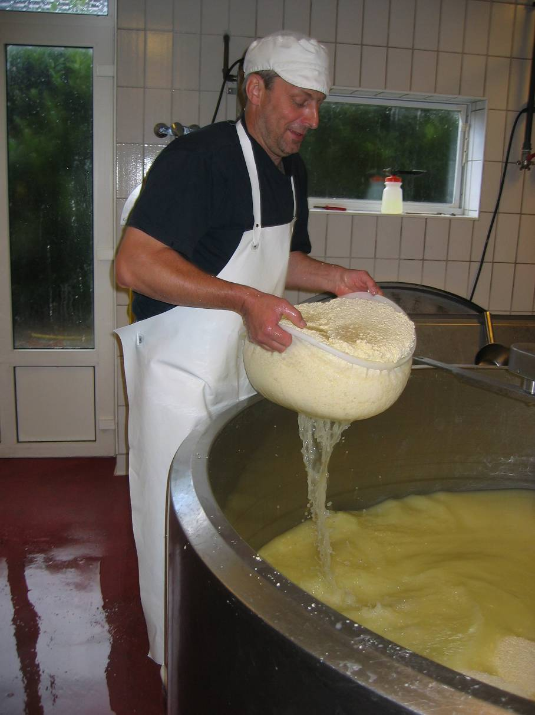
Who are the farmhouse and artisan cheese and dairy producers?
We are traditional but professionals
Food safety is one of our main concern as we are very close with our customers
we can perfectly comply with European regulations
…BUT we need
ADAPTIONS / DEROGATIONS / ADEQUATE INTERPRETATION
Notes:
I would remove the first point (it seems like we are angry, that it is!) and I wold put only one nice picture

Slide 8
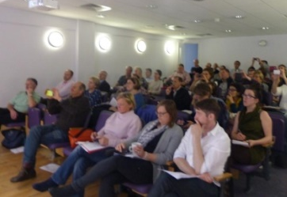
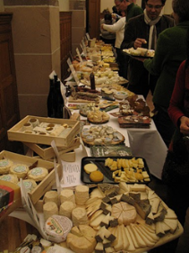
FACEnetwork’s actions
Aims: representation and defence of the interests of the farmhouse and artisan cheese and dairy producers on European level
1- Lobbying at european level
2- Exchanges of experience and leading of common projects
Hygiene/Regulation (> GGHP project)
Marketing of cheese and milk products
Cheesemaking technology
3- Annual meeting & congress
2009 | 2010 | 2011 | 2012 | 2013 | 2014 | 2015 | 2016 | 2017 | 2018 | 2019
FR Mirabel | IT Mals | DE Witzenhausen | ES Zafra | IRL Cork | NL Gouda | IT Milan | UK Worksop | AT Graz | SE Kristianstad | ES Valencia

Slide 9
One word about
FACE’s lobbying action
  Our experience is that the defense of farmhouse and artisan practices and products remains necessary
  - raw milk products (/emerging hazards…) are regularly questioned
  strategies of big industries to use names or images of artisan products with marketing goals…
  decision-makers may have “good intentions” for our sector, but they need to be more informed about our real needs
  Our lobbying topics in course are notably:
  Better approach about “local farming / direct sales”
  Nutritional labelling
  Labelling of milk origin
  Use of traditional materials
  Flexibility in the implementation of the Hygiene Package
  Etc…

Slide 10
The origins of the GGHP and the TEACHEESY projects
One essential goal of FACEnetwork = to demonstrate the quality and the safety of the farmhouse and artisan cheese and dairy products
2010 > Idea of an ambitious project in 2 steps:
1- production of a community Guide for Good Hygiene Practices
2- preparation of a large scale training program
2015-2017:
GGHP program
2017-2019: TEACHEESY program

Slide 11
The specificity and the strength of the GGHP:
Drafted by FACEnetwork: producers and technicians (20 persons – 10 countries)
Endorsed by the public authorities of the 28 Member States, and European Commission
Based on real practices and real needs of the producers
  Eg: no CCP, records only if non conformities, checkings based on producer’s know-how (organoleptic inspections…)…
Practical examples of flexibility and interpretations
> High level of recognition
> It is not « a Regulation » but applying the Guide allows to comply with the regulation

Slide 12
GGHP available in 24 languages…
English | français | español | Gaelige
čeština | eesti | latviešu | magyar
Malti | português | slovenčina | suomi
Deutsch | Nederlands | italiano | hrvatski
dansk | ελληνικά | lievtių | бъларски
polski | română | slovenščina | svenska

Slide 13
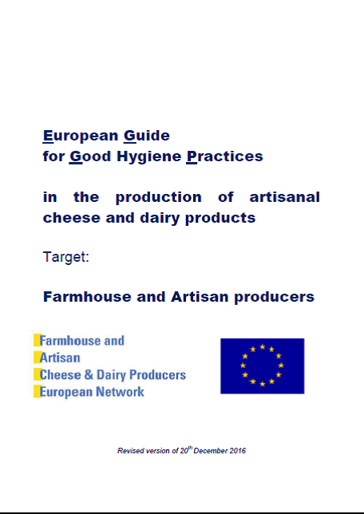
…on the website of the European Commission
https://ec.europa.eu/food/safety/biosafety/food_hygiene/guidance_en
(on this page, click on: “guidelines provided by stakeholders organizations” and then on “EN/…” close to “European GGHP in the production of ARTISANAL cheese and dairy production”).

Slide 14
SECOND STEP: TEACHEESY
Development of tools for (training of) producers on how to use the GGHP
Building network of ‘technicians with spirit of GGHP’
Diffuse the GGHP over Europe
Technicians, producers and advisors: 18 organisations from 14 countries
Already involved in production of GGHP

Slide 15


SECOND STEP: TEACHEESY
Teacheesy is an European project funded by Erasmus+ programme of the European Union
The project is aimed at facilitating the use of the Guide to Good Hygiene Practices [GGHP] in all EU countries. Teacheesy aims to create and provide the necessary training tools and methodologies required by qualified technicians and trainers which will, in turn, be used to instruct farmhouse and artisan cheesemakers across the whole of Europe on a common policy for good hygiene in cheesemaking.
https://www.face-network.eu/teacheesy

Slide 16
THIRD STEP
FACE in itinere

Slide 17
A
FACE in itinere - Objectives
“To provide to current and prospective cheese and dairy makers and retailers a better access to trainings adapted to their needs. This project will put a specific attention to open opportunities for experiences in real working situation (internships, co-working periods…) as essential complements to “classical” education.”

Slide 18
FACE in itinere - Content
From September 2019 to December 2020 (16 months) – 3 workstreams:
WS 1 – Building a web-based platform to exchange offers/requests of stages/co-working/visits
WS 2 – Building an online inventory of training courses
WS 3 – Identifying specific needs for training courses

Slide 19
Artisan cheesemaking in Poland
Situation after the second war
Collectivization and nationalisation
Prohibition of private food processing activities
All primary food products had to be supplied to the state
Result?

Slide 20
Artisan cheesemaking in Poland
Situation after the second war
Destruction of small food processing and small local processors
Disapearance of knowledge and experience of milk processing on small scale
BUT
Many private small farms „survived” this process and some farmers still made some products in home for their use only.

Slide 21
Artisan cheesemaking in Poland
Situation after 1989 y.
The possibility of doing business in various fields, including agriculture.
Open borders, growing turism, demand of more tasty products
Higher awareness of healthy food
Looking for more natural products without to many additives
Growing demand for farmhouse and artisan dairy products

Slide 22
Artisan cheesemaking in Poland
Situation after 1989 y.
Many of small producers saw an opportunity to develop a new activity on a new field but:
they faced a couple of problems:
  lack of technological knowledge
  lack of knowledge of microbiological processes
  lack of market and distribution channels „ready to use”
  lack of suppliers providing technological additives, moulds and equipment adapted to smal production scale
  lack of knowledge of legal and sanitary regulations
  mutual relations with control authorities

Slide 23
Artisan cheesemaking in Poland
How are they trying to place their products on the market?
Family and neighbours
Local markets
Different fairs and exibition
Eko-shops, restaurants..
Websites and fanpages
Internet sale
Farm visits, product testing
Leaflets, advertising brochures

Slide 24

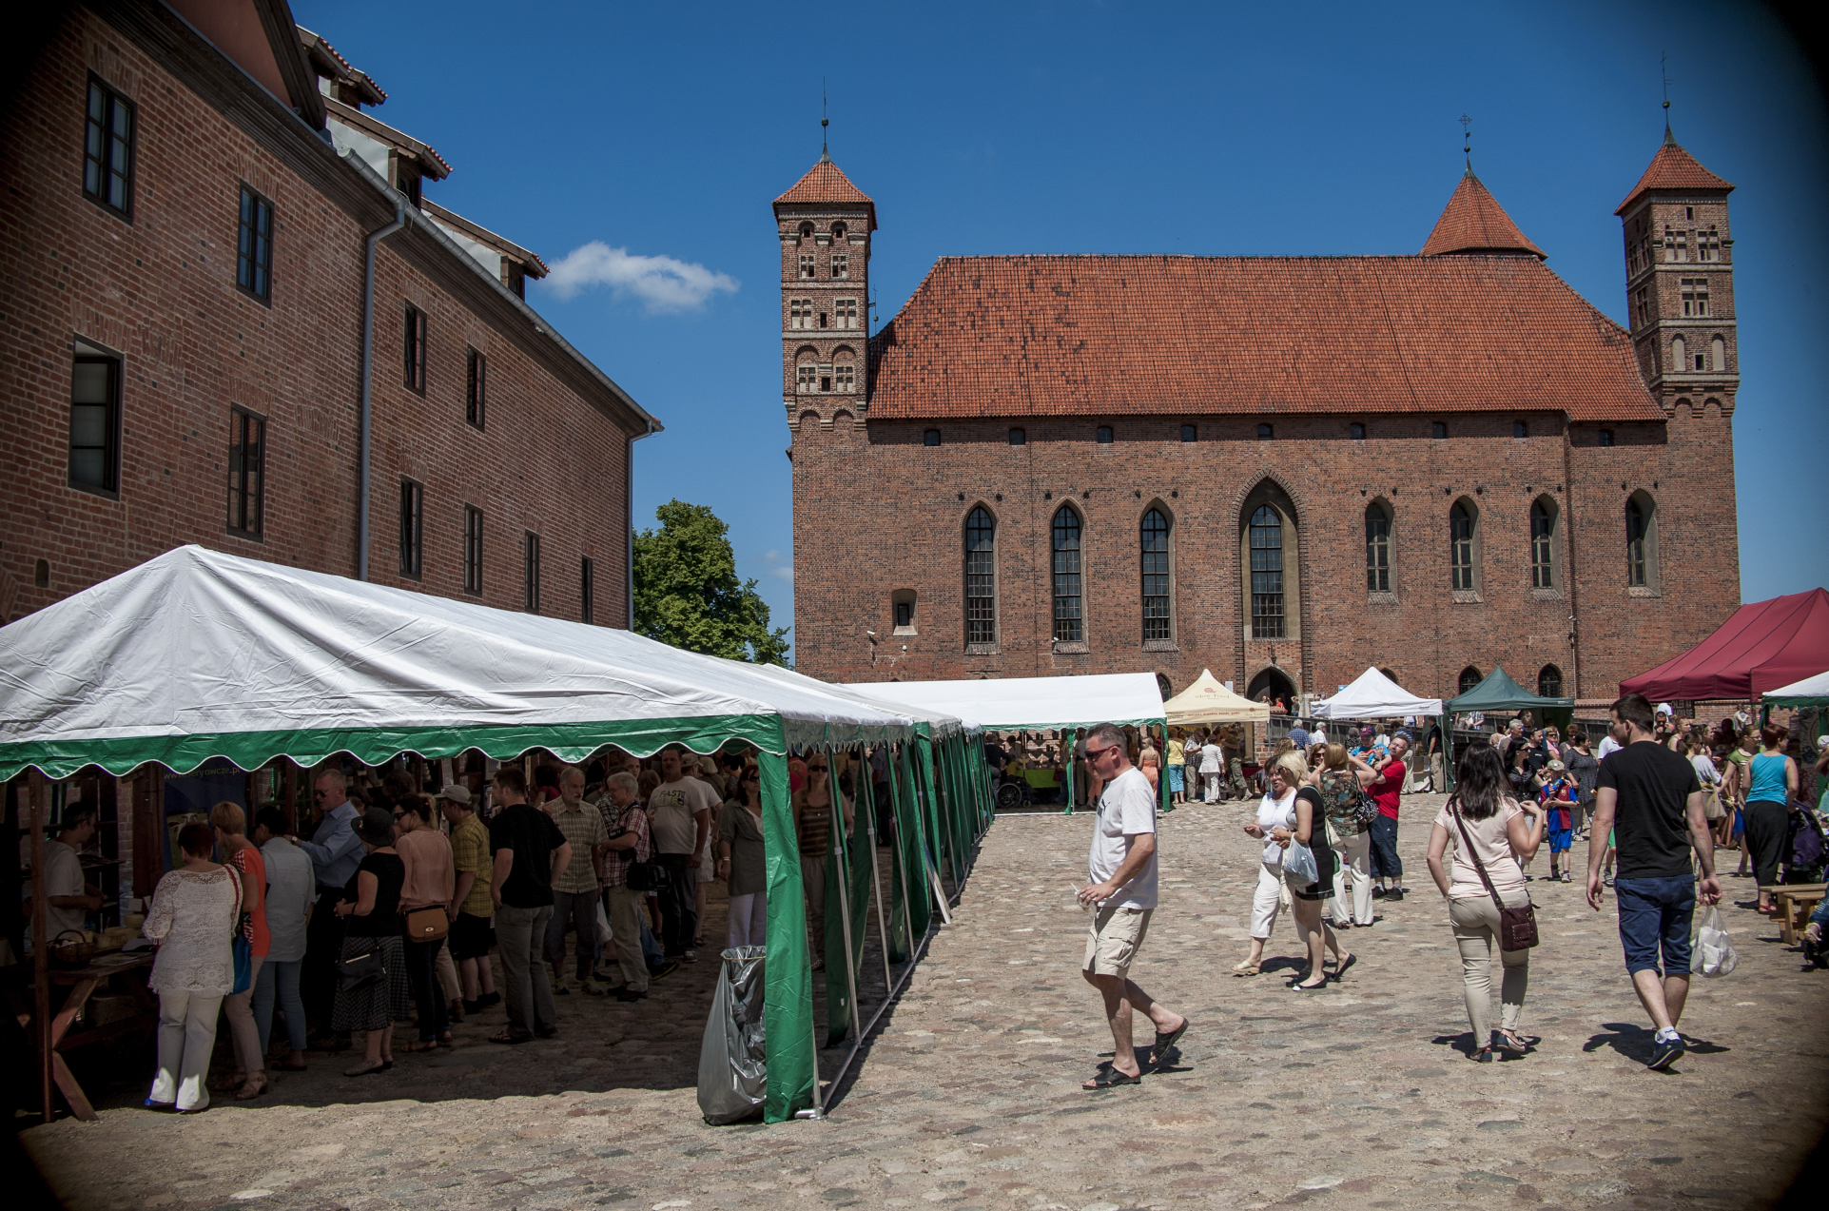
Nationalwide Farmhouse and Artisan Cheeses Festival „Czas na Ser” in Lidzbark Warm

Slide 25
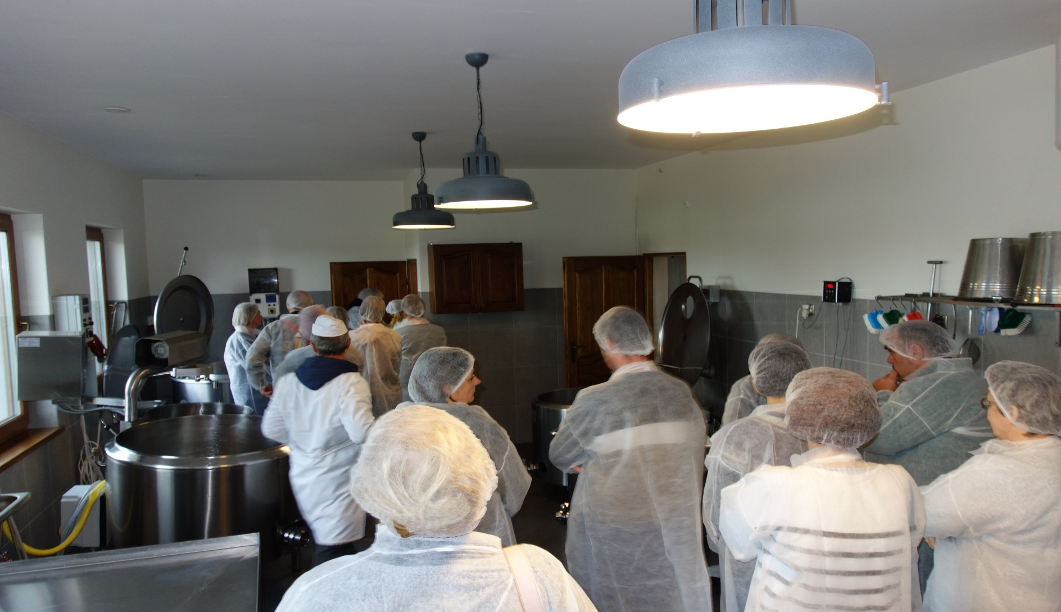
Farm visit

Slide 26
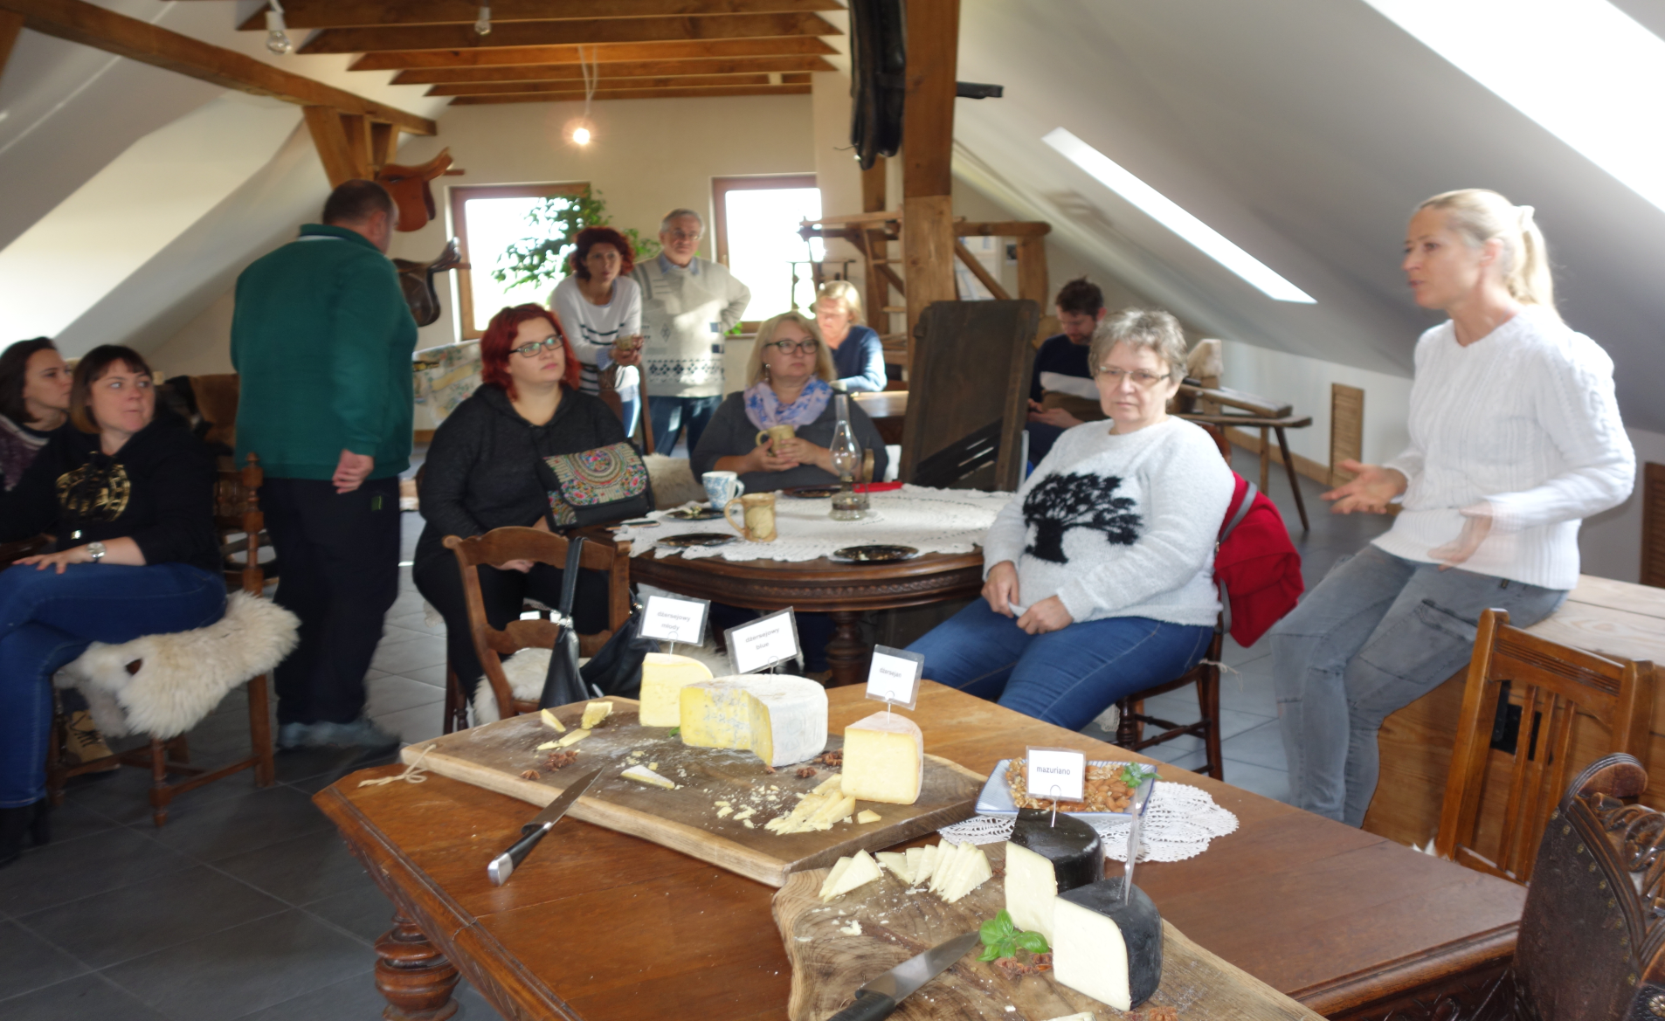
Product testing

Slide 27
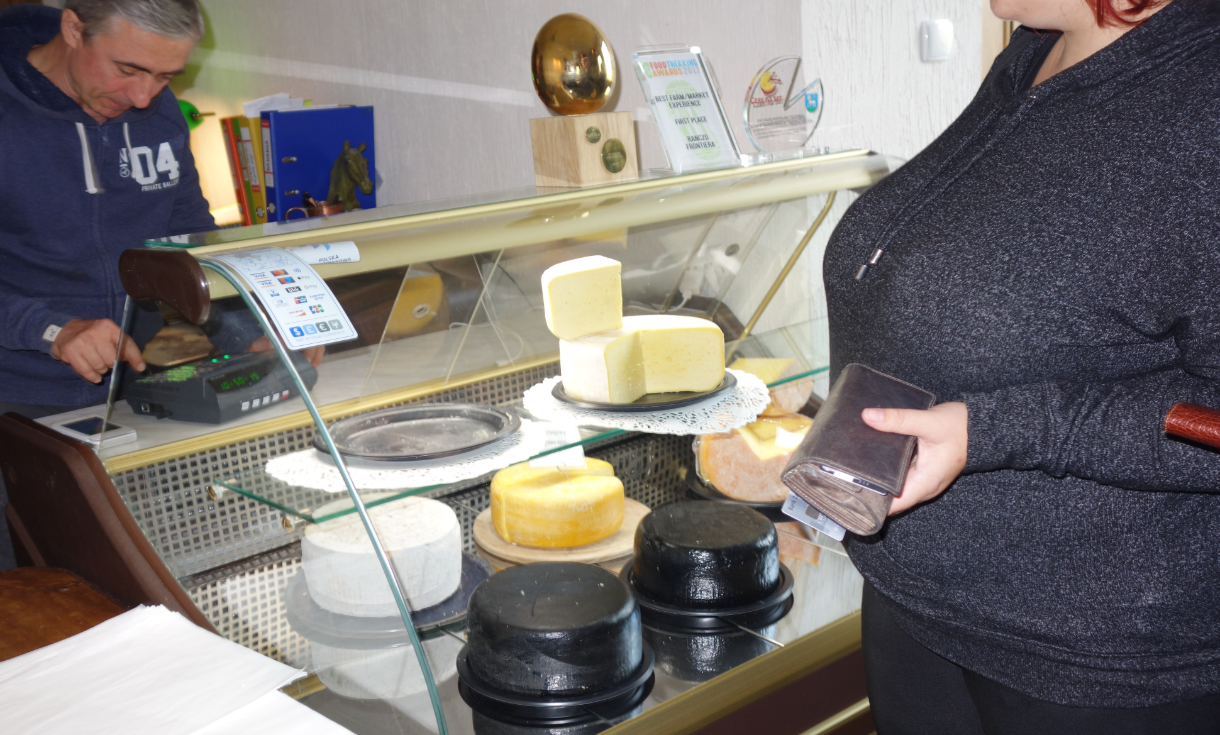
Farm shop

Slide 28
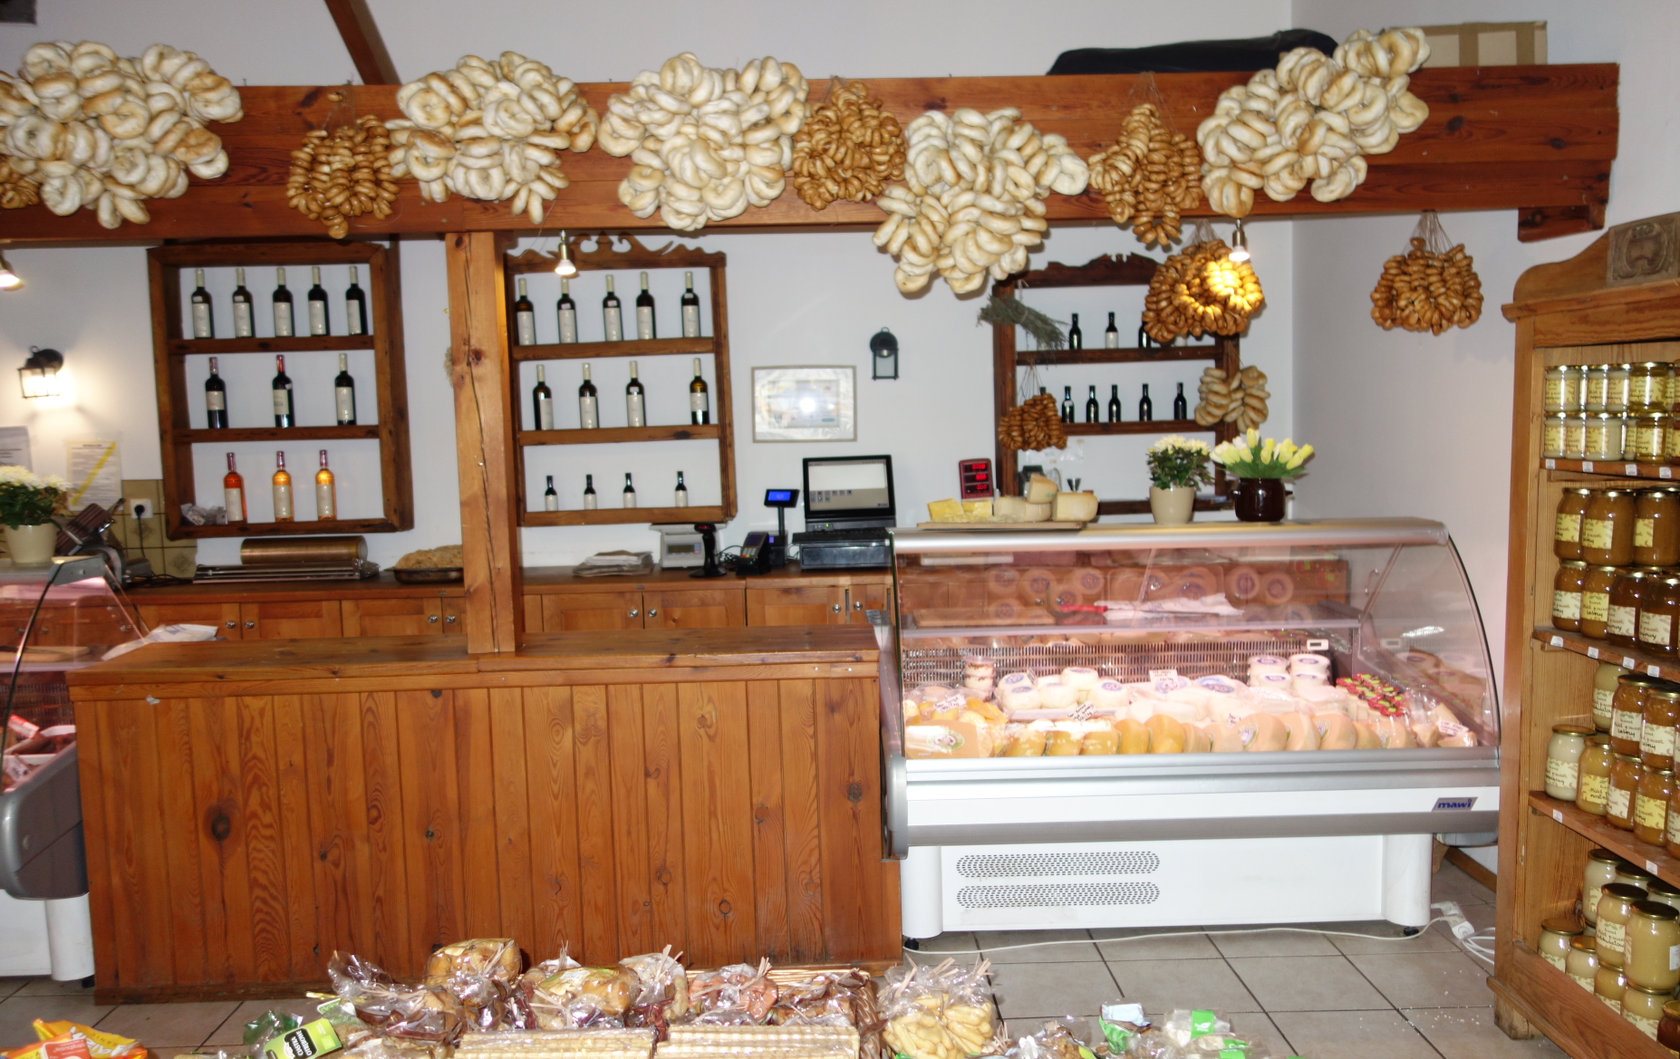
Farm shop

Slide 29
Artisan cheesemaking in Poland
What are the requirements for small producers?
Respect European hygienic package:178/2002, 852/2004, 853/2004, 882/2004,2073/2005, 1169/2011
Prepare appropriate premises for production respeting GHP and GMP principle.
Register their activity at relevant institution.
Regularly test products according to the developed plan
Monitor and record important production data.

Slide 30
Artisan cheesemaking in Poland
What are the forms of activity for small producers?
Agricultural retail
Local, Marginal and Limited
Approved

Slide 31
Artisan cheesemaking in Poland
Thank you for your attention !

